Slide 1
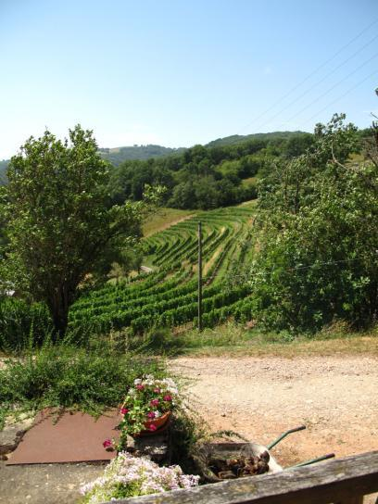
The vineyards from the porch at the house in Marcillac where some of the steepness of the vineyards are visible.

Slide 2
Fer Servadou in Marcillac
Marcillac is an appellation for unique red wines made in a small area of the Aveyron department of South West France. Fer vines climb the steep hillsides in this small corner of France, giving rise to a spicy, aromatic red wine that responds well to barrel maturation.

Slide 3
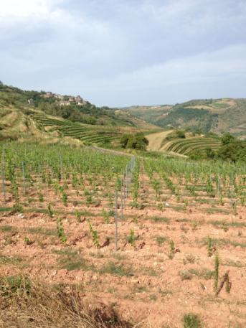
The valley draws warm and dry air from the Mediterranean during the summer and fall and also shelters the vineyards from the harsh winters.

Slide 4
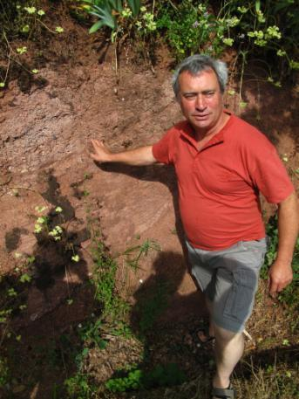
Vineyards are planted on iron-rich limestone clays, which are known locally as les rougiers due to their reddish color

Slide 5
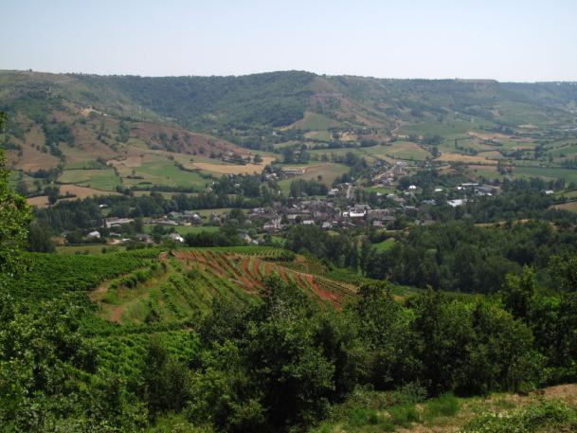
The soil is visibly red and can be seen from a distance.

Slide 6
Soil and hillsides are essential.
These soils have good water retention, and high levels of rainfall in the spring can provide enough water to hydrate vines throughout the warm, dry summers. The natural slope of the vineyard ensures that any excess water is efficiently drained away.

Slide 7
“Vieilles Vignes” Marcillac 2014
Philippes wines are made from one grape type, the local grape of Marcillac, Fer Servadou.
The Cuvee Vieilles Vignes is made from a parcel of vines that is over 80 years of age. The fermentation is carried out at a slightly warmer temperature than the regular cuvee and the maceration is extended to 5 weeks. The wine is aged in large oak and chestnut barrels for at least a year before bottling.
Reports for 2014 from all parts of France indicated fairly uniform weather patterns for the initial growing season, marked by an usually warm winter, during which the vines did not go completely dormant. Then a wet, warm beginning of spring, resulting in early bud-break, but well before threat of frost was passed. A nail biting start to the season. Thankfully, in general, the beginning of summer through mid-July brought overall good weather, warm and dry, and the accelerated development of the growing cycle regained its normal rhythm. Late July through August, conditions varied according to region, with unpredictable weather in many parts. September regaled, bringing sunshine and beautiful harvest conditions ; for most 2014 is a successful vintage of very good quality, but for some, small quantity.

Slide 8
Fer Servadou
Fer or Fer Servadou is the generic name of this grape. Fer is the French translation of "Her" in Occitan language, itself derived from "Ferus" in Latin, meaning "savage". Servadou refers to the Occitan language "Servador" which means able to be kept.
Mansois as it is known locally is a grape variety is found throughout the Sud-Ouest wine region, but Marcillac is its spiritual home: no other appellation uses Fer as the key grape variety.
Small amounts of Cabernet Sauvignon, Merlot and Prunelard are also allowed in the blend to tame Fer's tannic nature although, in practice, most Marcillac wines are 100 percent Fer.

Slide 9
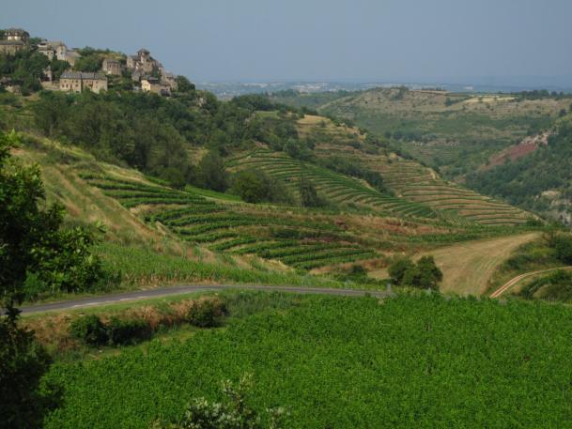
Pictures = 1,000 words
(the steep slopes of Marcillac)

Slide 10
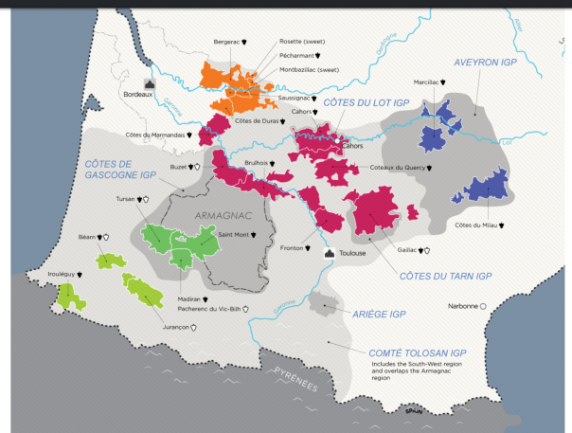
Cahors is the most famous of the many appellations in South West France.

Slide 11
Cahors
The celtic Gauls were conquered by Julius Caesar in 50 BC the town, they were one of the last to be conquered by the advancing army of Caesar.
The town of Cahors is situated about 70 miles north of Toulouse.
The area around Cahors produces a robust and tannic red wine. Wine from the Cahors appellation must be made from at least 70% Malbec (also called Cot, Auxerrois and Pressac) grape, with a maximum of 30% Merlot or Tannat grape varieties.
Malbec is a purple grape variety used in making red wine. The grapes tend to have an inky dark color and robust tannins, and are known as one of the six grapes allowed in the blend of red Bordeaux. The French plantations of Malbec are now found primarily in Cahors. It is increasingly celebrated as an Argentine wine and is being grown around the world. We have seen recent labels of Cahors wines listing Malbec as the variety on their labels, not something we’ve seen 15 years ago.

Slide 12
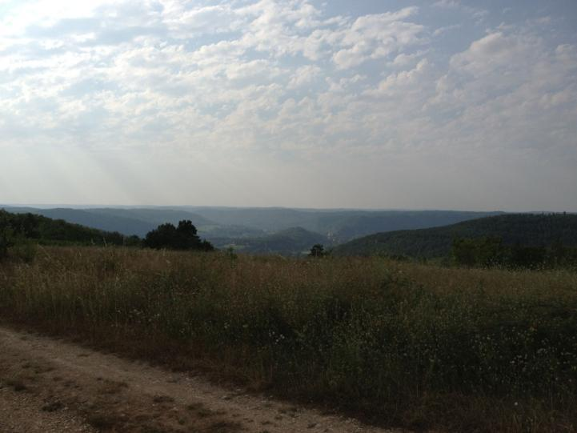
Chateau la Caminade “La Commandery” Cahors 2012

Slide 13
NO CABERNET either SAUVIGNON OR FRANC
In wine terms it is known for its deeply colored reds made predominantly from Malbec (known locally as both Côt and Auxerrois), with small quantities of Tannat and Merlot.
Interestingly, Cahors is the only red-wine appellation in the French south-west to use neither Cabernet Sauvignon nor Cabernet Franc.
The typical Cahors wine is darkly colored and has a meaty, herb-tinged aroma, with hints of spiced black cherries and a whiff of cedar. Cahors is invariably tighter and leaner than the rich, opulent style of Malbec being made in the variety’s new-found home in Mendoza, Argentina.

Slide 14
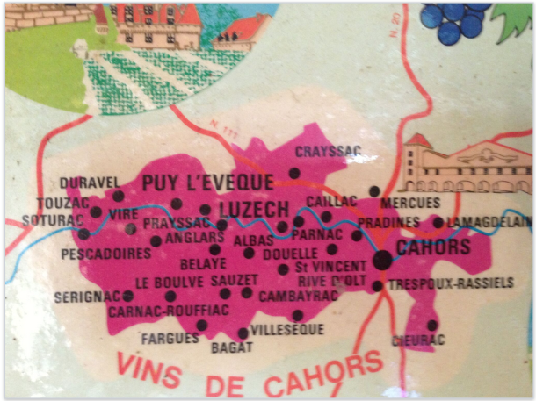
Wines of Cahors

Slide 15
Foods that come from the region and are particularly well suited to Cahors wine pairing
Braised leg of lamb or lamb shanks
Braised beef stews or short ribs especially with smoked bacon (Malbec’s also a good wine to add to a stew)
Pot roast
Pheasant
Duck confit especially good with Cassoulet and other pork and bean dishes and flavorsome sausages with garlic

Slide 16
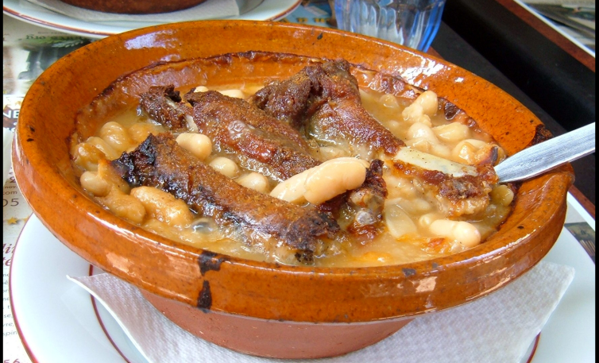
Cassoulet is perhaps the best known South West dish.

Slide 17
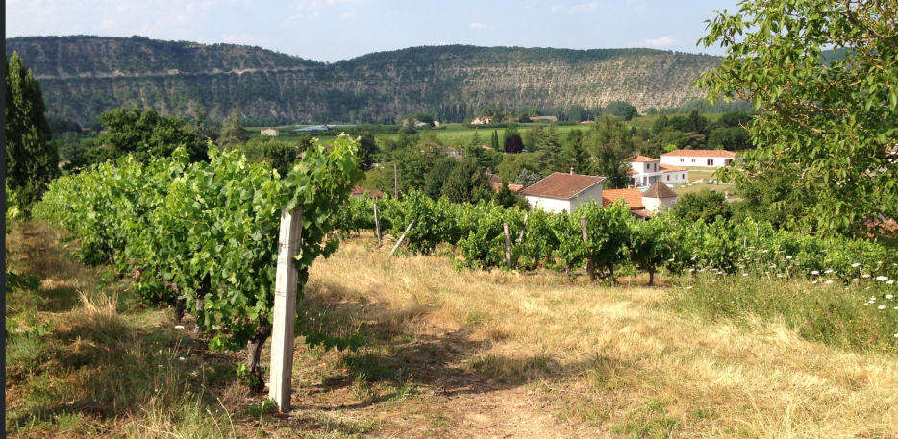
Cahors in August 2013. A devastating hail destroyed some of the region this year.

Slide 18
Hail can make a difference in agriculture within a matter of minutes possibly seconds.
On 23rd June 2013 some 250 hectares of vineyards in the Cahors region of the Lot had been destroyed by hail. Rain and storms that month had also reduced yields by up to 30% in Madiran.
In addition to the loss of photosynthetic area i.e. the leaves, stem bruising and callouses can lead to yield and late-season stem/stalk breakage. Injury to stems can lead to later infestations by sap beetles, and infestations of migratory armyworms are often worse in grassy corn or lodged cereal grains in areas where hail has occurred.

Slide 19
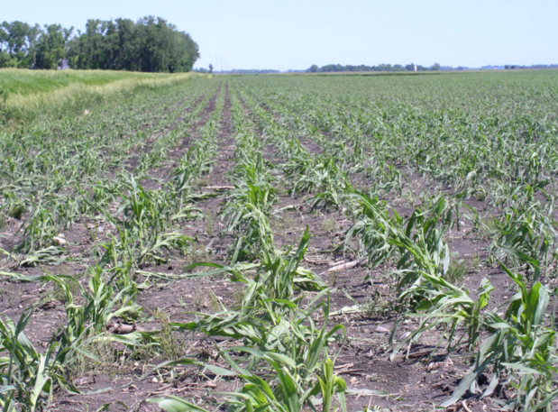
Corn fields in Kandiyohi County Minnesota in June this year (2017) damaged by hail.

Slide 20
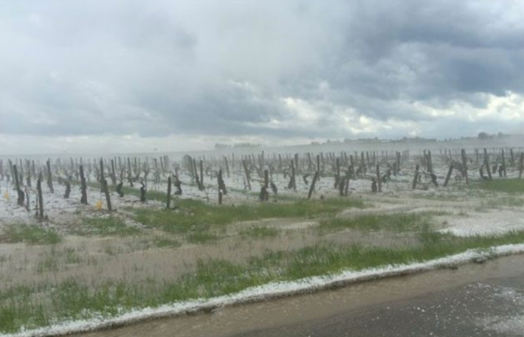
Hail storms

Slide 21
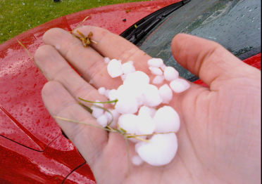
Hail, even more than frost, is the wine grower's enemy because it can strike so swiftly. Hail can shatter vines, destroy young buds and, later in the season, ruin whole vineyards full of growing fruit. What's more, hail can damage vines so severely that the following year's crop can be affected, too.

Slide 22
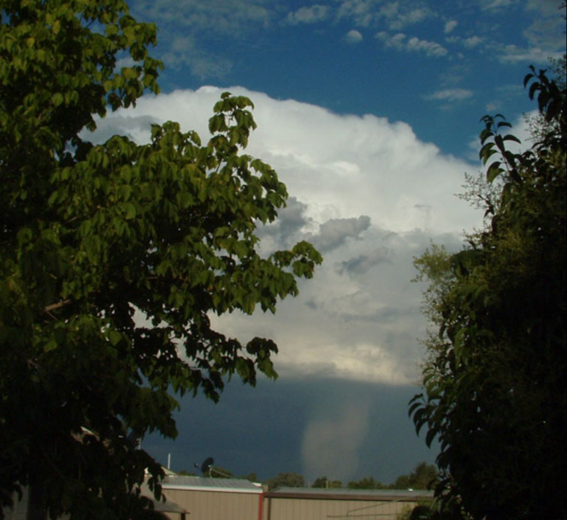
Hail Shaft

Slide 23
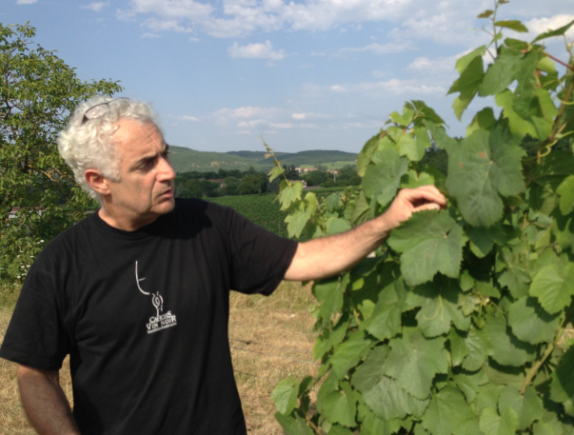
Dominique Ressès owns 34 hectares in Cahors

Slide 24
CHATEAU LA CAMINADE is in PARNAC
Luckily their vineyards were spared in 2013’s hail storms
Parnac is very close to Pradines.
The 35 hectare property and vineyard has been in the family for four generations. Just before the revolution the vineyard belonged to a monastery.

Slide 25
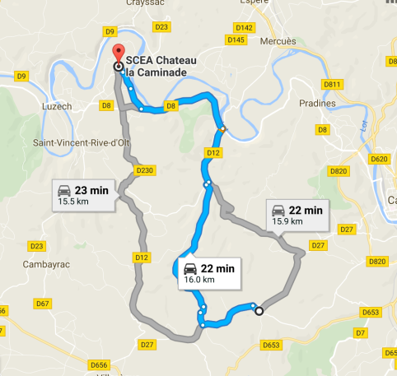
22 minutes away and about 16 Kilometers (about 10 miles away) another vineyard I work with was completely destroyed.

Slide 26
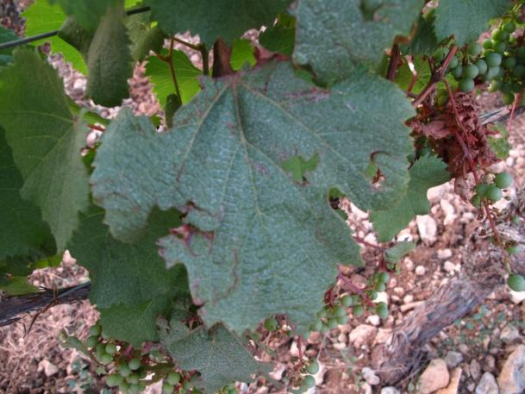
Vines damaged by hail

Slide 27
La Commandery 2012 Cahors
This wine comes from the best parcels in the La Caminade vineyard. Typically it is from parcels of old vines growing on the “third terrace”, but the final selection is made after the fermentations have occurred. For this cuvee, the Ressès try to use exclusively Auxerrois (Malbec) although sometimes a small amount of tannat is blended for complexity. The harvest is triaged (sorted) before entering the vat house and fermentations are done in temperature controlled stainless steel vats. Maceration is extended to five weeks. M. Ressès has devised a system that allows for very gentle pumping of the juice over the cap. The wine is aged in oak barrels, typically one third new, for one year. The result is a deep and concentrated wine that typifies the Quercy region.

Slide 28
Domaine Brana Irouleguy
Irouleguy is a small wine region located 125 miles (200km) south of Bordeaux in Le Pays Basque – the French Basque Country. This is about as far south in France as it is possible to go before crossing the Pyrenees Mountains into the Pais Vasco of northern Spain. The region produces fruity, tannic red wines and full-bodied, tangy whites. Less well known and arguably under-rated are its intensely fruity and deeply colored rosés.

Slide 29
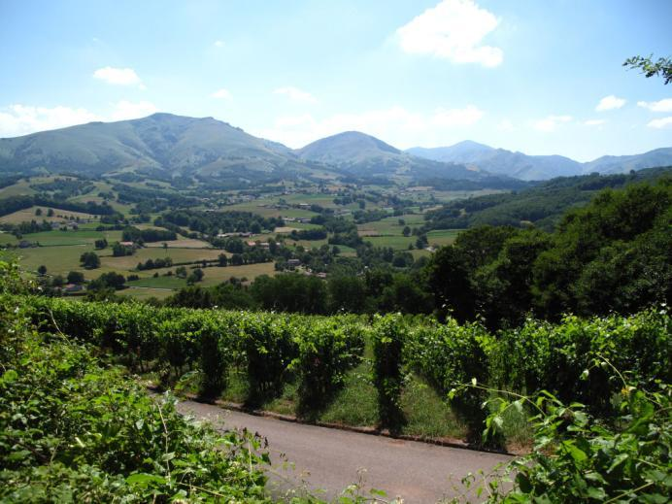
Domaine Brana

Slide 30
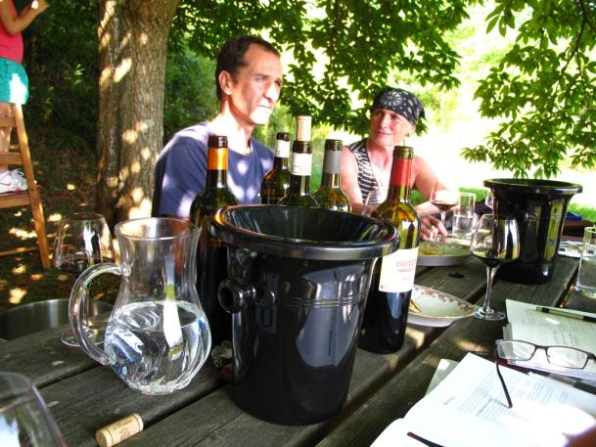
Domaine Brana “Harri Gorri” Irouleguy Rouge 2013
Jean and Martine Brana (brother and sister) farm about 22 ha in Irouleguy

